Slide 1

Paper Overview
Accelerating Hybrid Systems Differential Dynamic Programming
John Nganga

Slide 2
Paper Sections
Abstract
Introduction
Specific Contributions
Background: Trajectory Optimization
Differential Dynamic Programming
Hybrid Dynamics
Hybrid systems DDP Algorithm
Dynamics Function Realization
Alleviating Computational Complexity in DDP
Conventional Partials
Explicit Partials
Extended Modified RNEA Partials
Summary
Results
Discussion
Conclusion

Slide 3
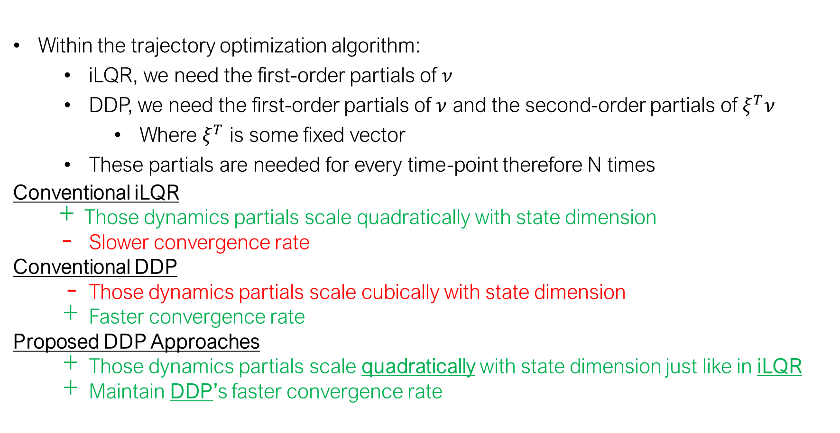
Hybrid Dynamics
KKT Dynamics:
Re-definition
Within the trajectory optimization algorithm:
iLQR, we need the first-order partials of $ν$
DDP, we need the first-order partials of $ν$ and the second-order partials of $ξ^{T}ν$
Where $ξ^{T}$ is some fixed vector
These partials are needed for every time-point therefore N times
Conventional iLQR
Those dynamics partials scale quadratically with state dimension
Slower convergence rate
Conventional DDP
Those dynamics partials scale cubically with state dimension
Faster convergence rate
Proposed DDP Approaches
Those dynamics partials scale quadratically with state dimension just like in iLQR
Maintain DDP’s faster convergence rate

Slide 4
Partials
KKT Dynamics:
Conventional iLQR
First partials:
Conventional DDP
Second partials:
Proposed DDP Method: Explicit Method
Second partials:
Notes:
Xxi
This is one approach I took. I have another DDP approach but it is more involved

Slide 5
Partials
KKT Dynamics:
Reverse Mode Auto-Differentiation
Conventional iLQR
First partials:
Conventional DDP
Second partials:
Proposed DDP Method: Explicit Method
Second partials:
Notes:
Xxi
This is one approach I took. I have another DDP approach but it is more involved

Slide 6
Derivation of First Partials
KKT Dynamics:
First partials:
Where:

Slide 7
Results [Figures from Paper]

Slide 8
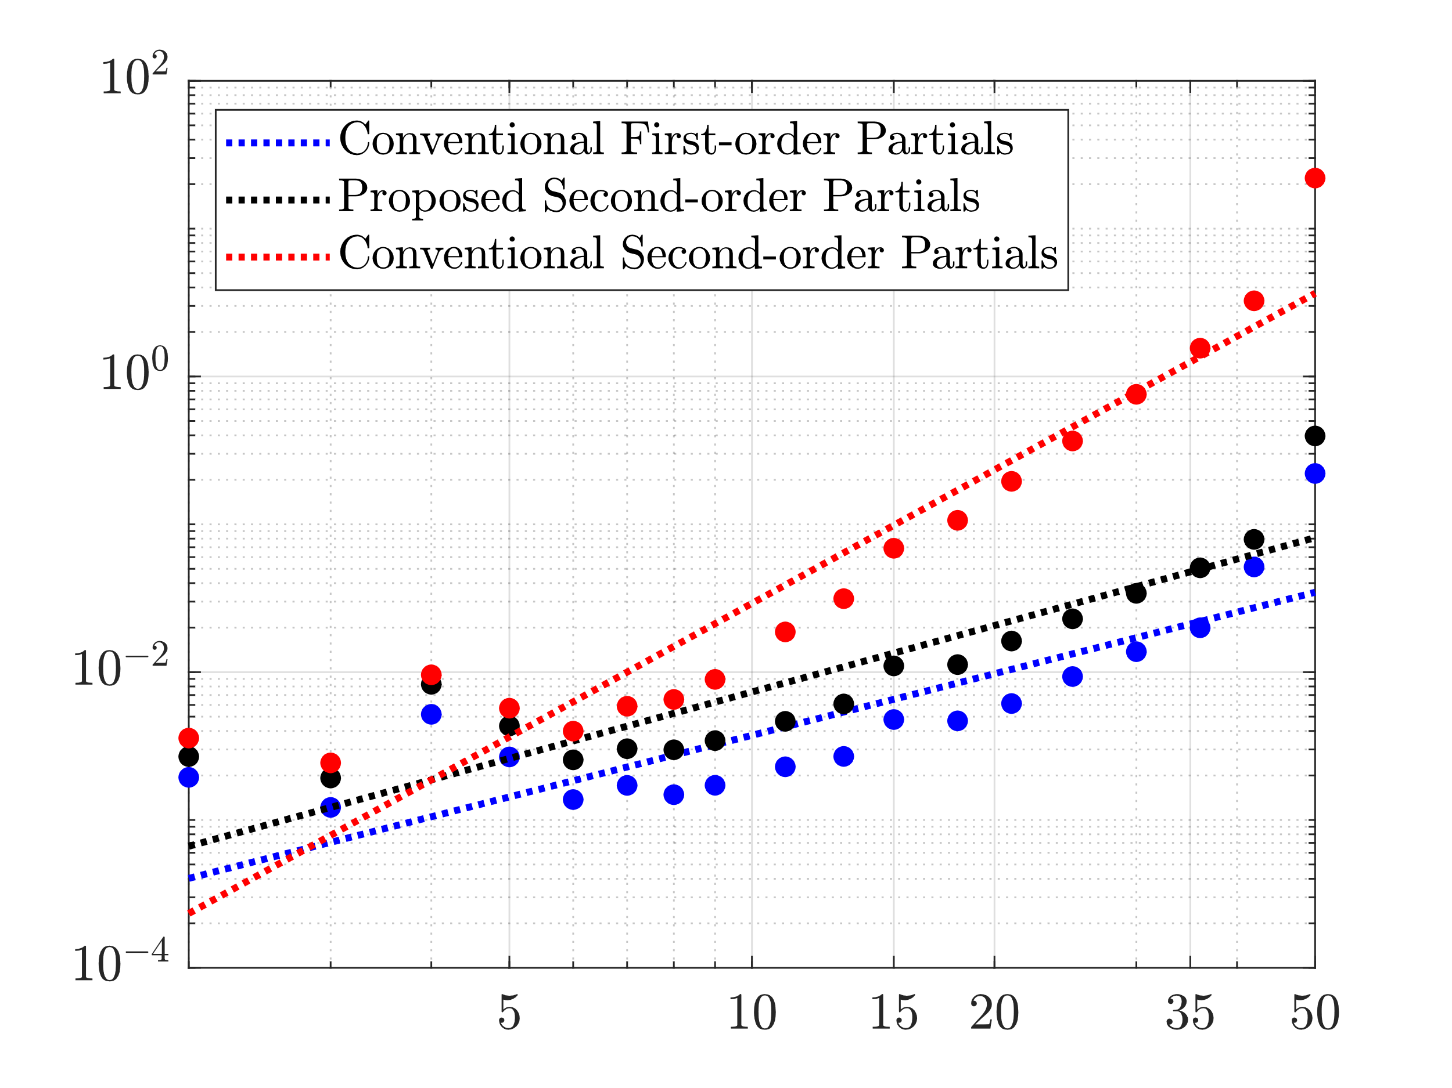
Benefits of the Proposed Methods: Pendubot Model

Slide 9
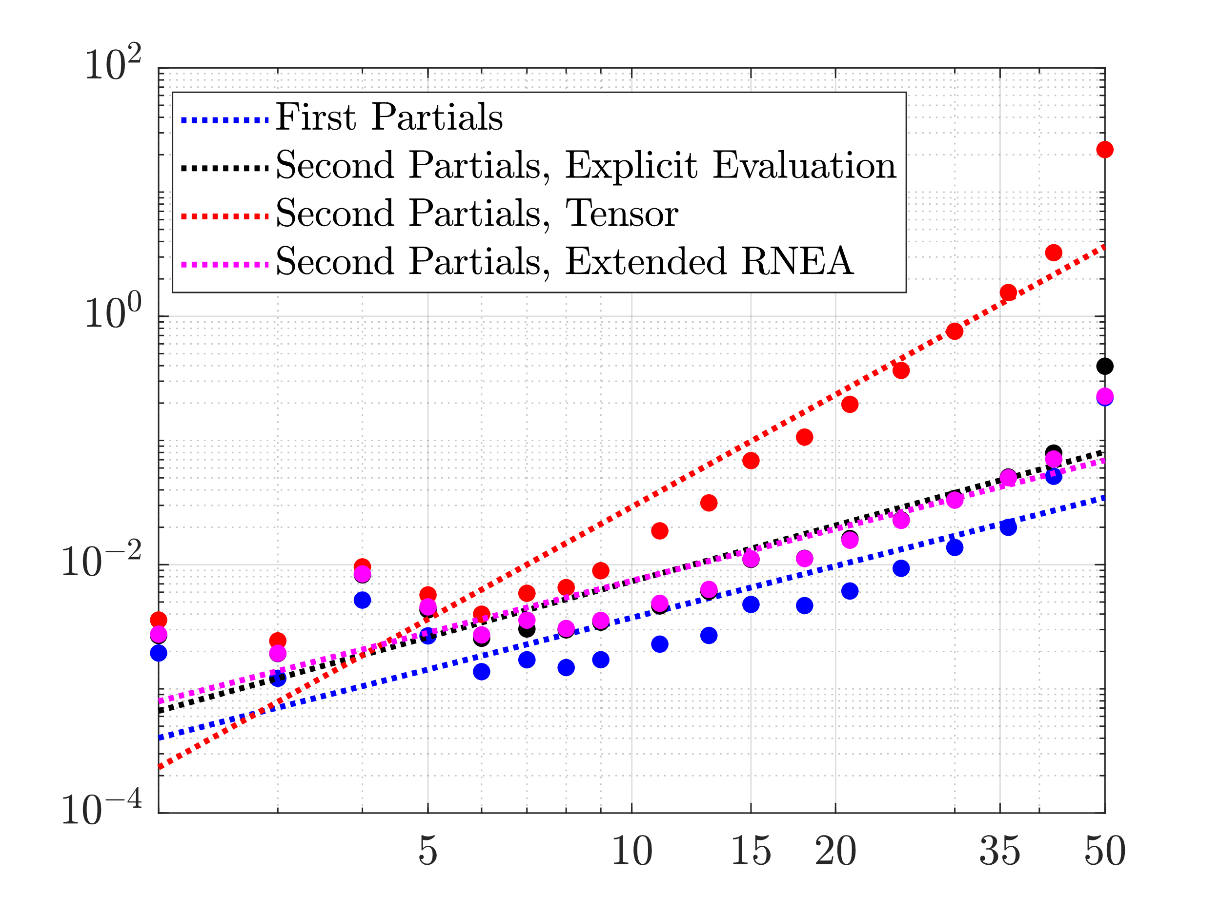
Partials Calculation vs DoFs: Pendubot Model

Slide 10
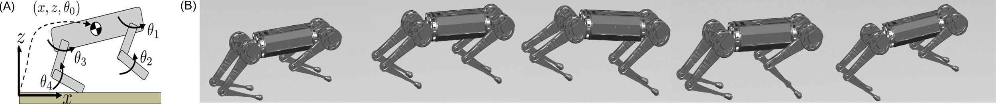
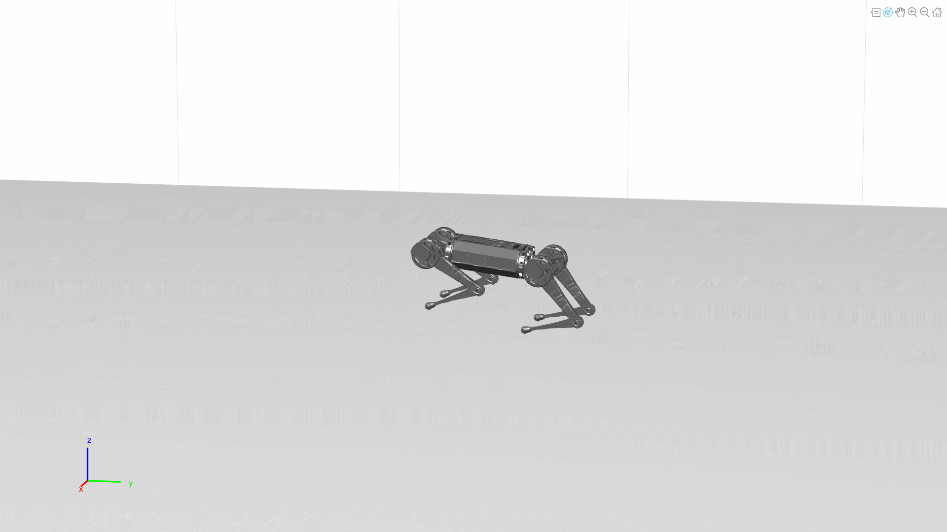
Resulting Motion: Quadruped
(A) The state-space of the quadrupedal model. (B) Snapshots of the resulting optimized motion by iLQR/DDP including the ground reaction forces.

Slide 11
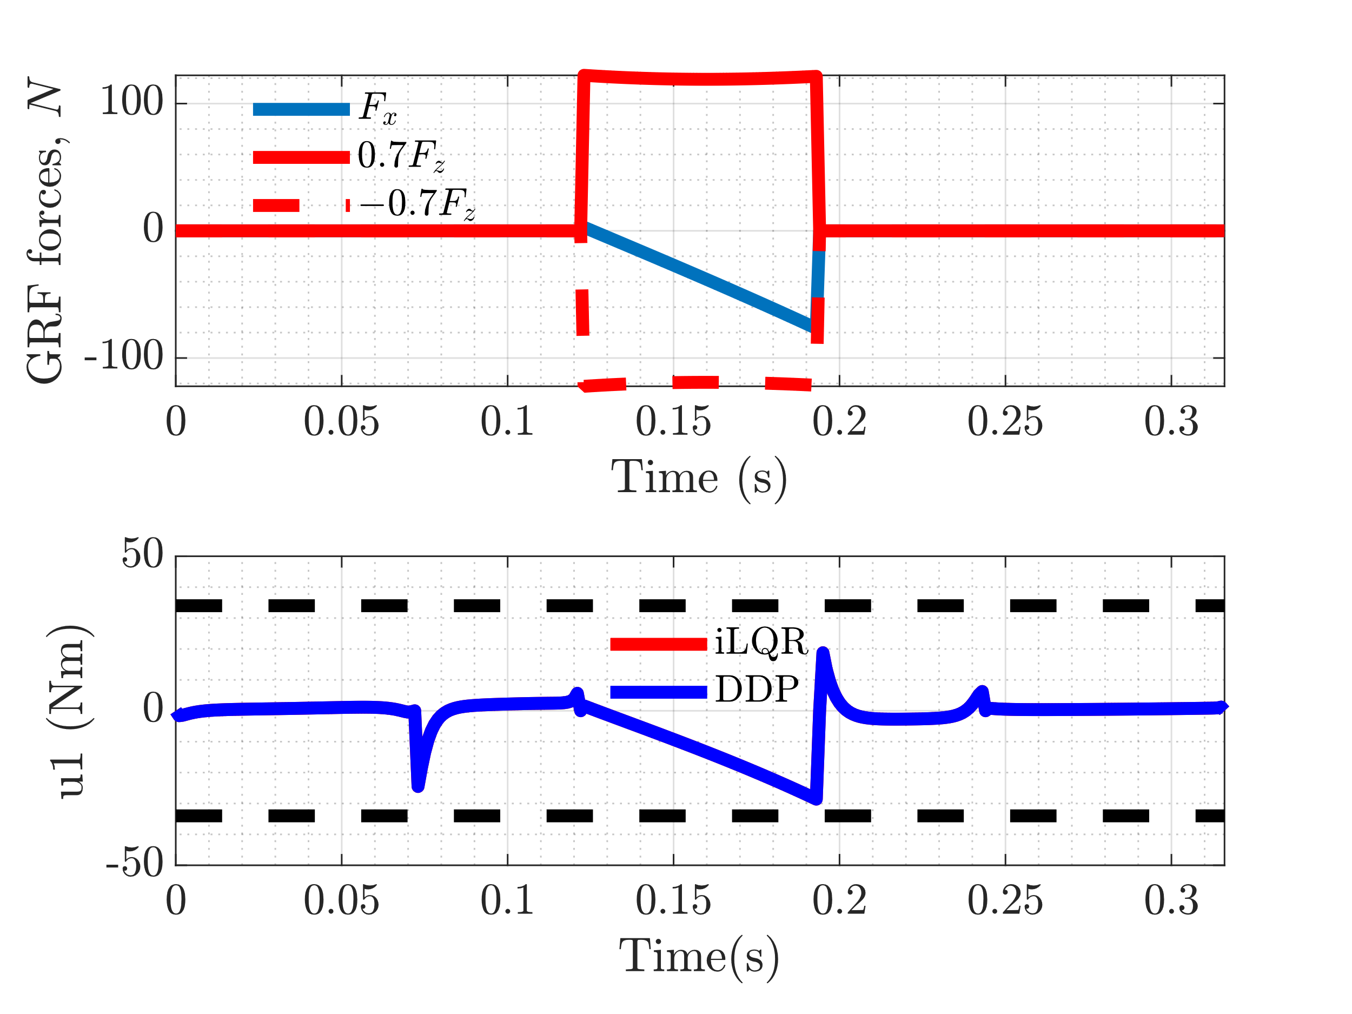
Constraints Met
(a) Ground Reaction forces satisfying the friction cone constraint. (b) Joint torque control satisfying the control limits

Slide 12
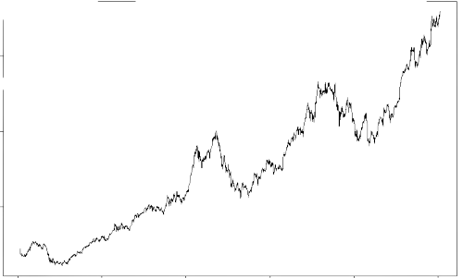
[Not in the Paper] Add Noise to Trajectory
Trajectory
Control
Initial
Intermediate
Optimal
Control
Trajectory
Significant noise that iLQR does not recover
Run either iLQR/DDP to convergence

Slide 13
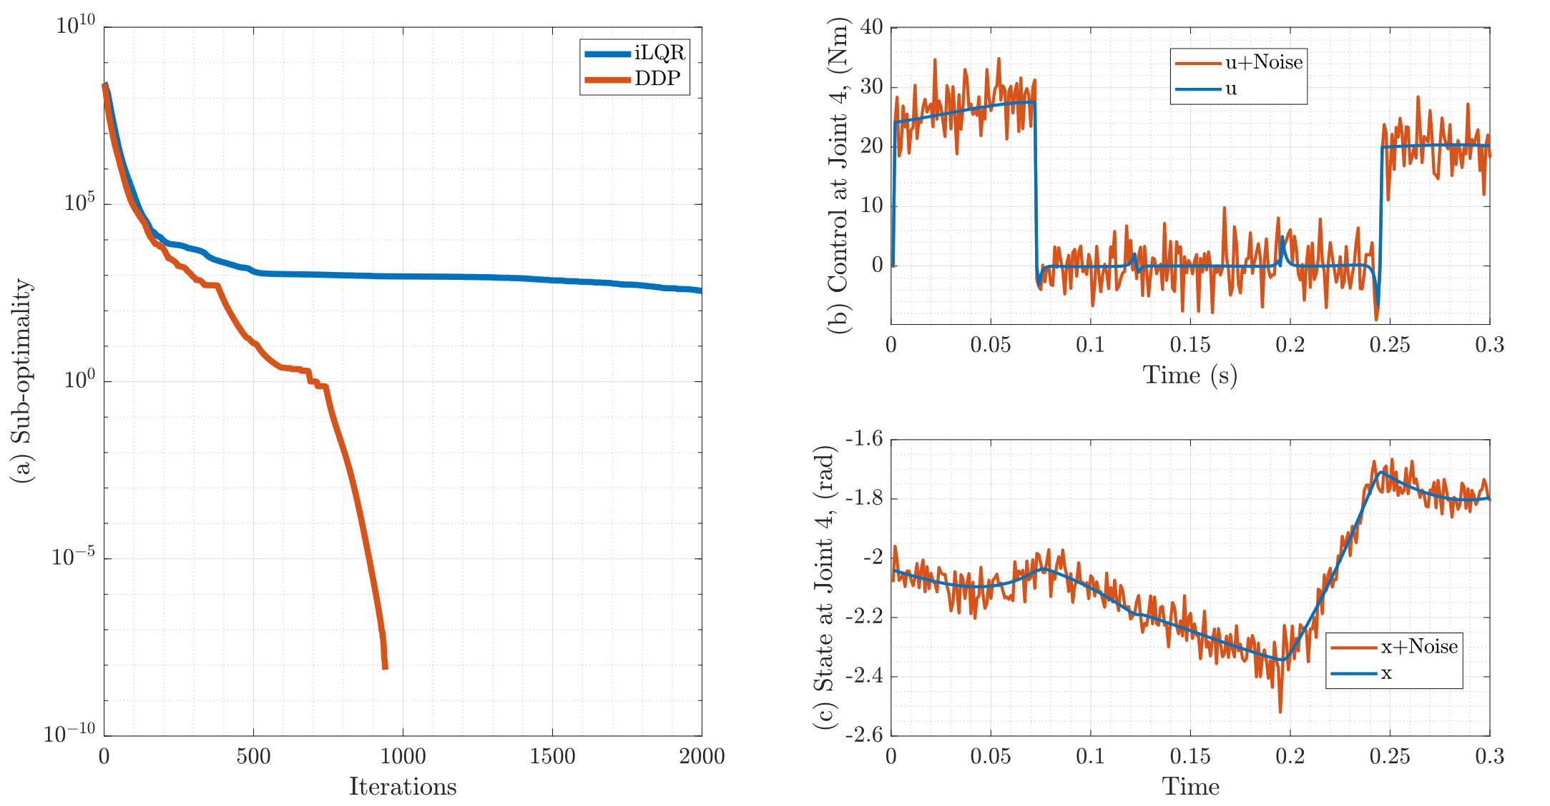
Optimization Following Noise Addition
(a) Sub-optimality following introduction of (b) control noise and (c) state noise

Slide 14
[Not in the Paper] Add Noise to Trajectory
Trajectory
Control
Initial
Intermediate
Optimal
Control
Trajectory
Run either iLQR/DDP for some 30 Iterations

Slide 15
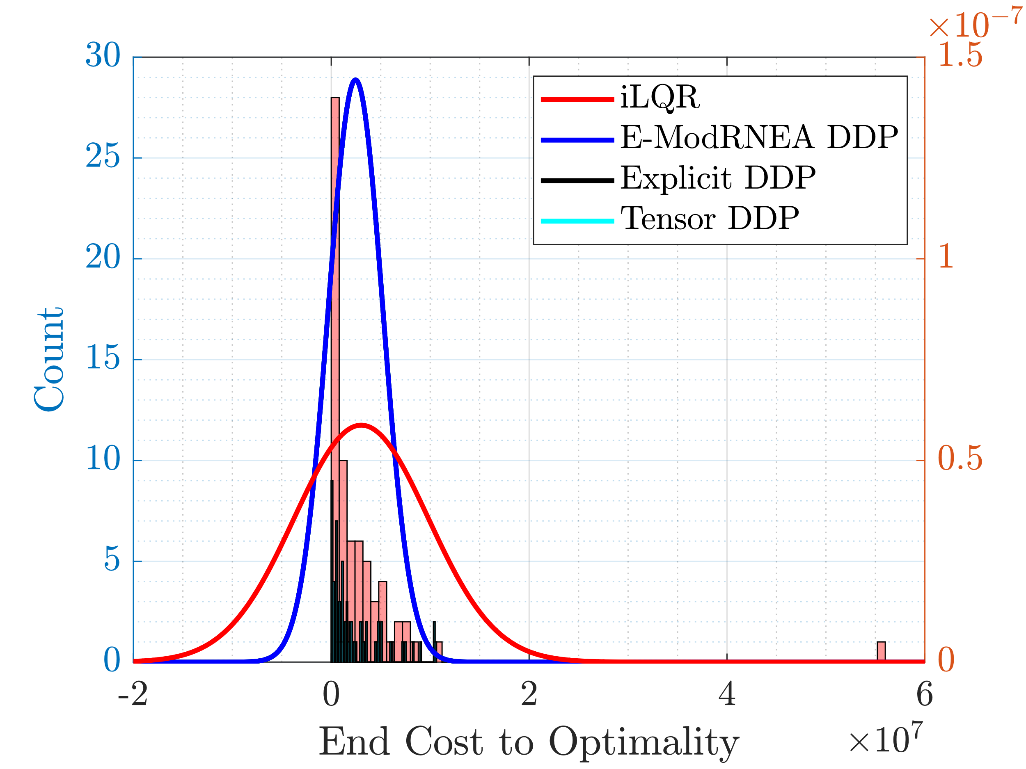
Probability Density Estimate of the Sub-optimality Gap

Slide 16
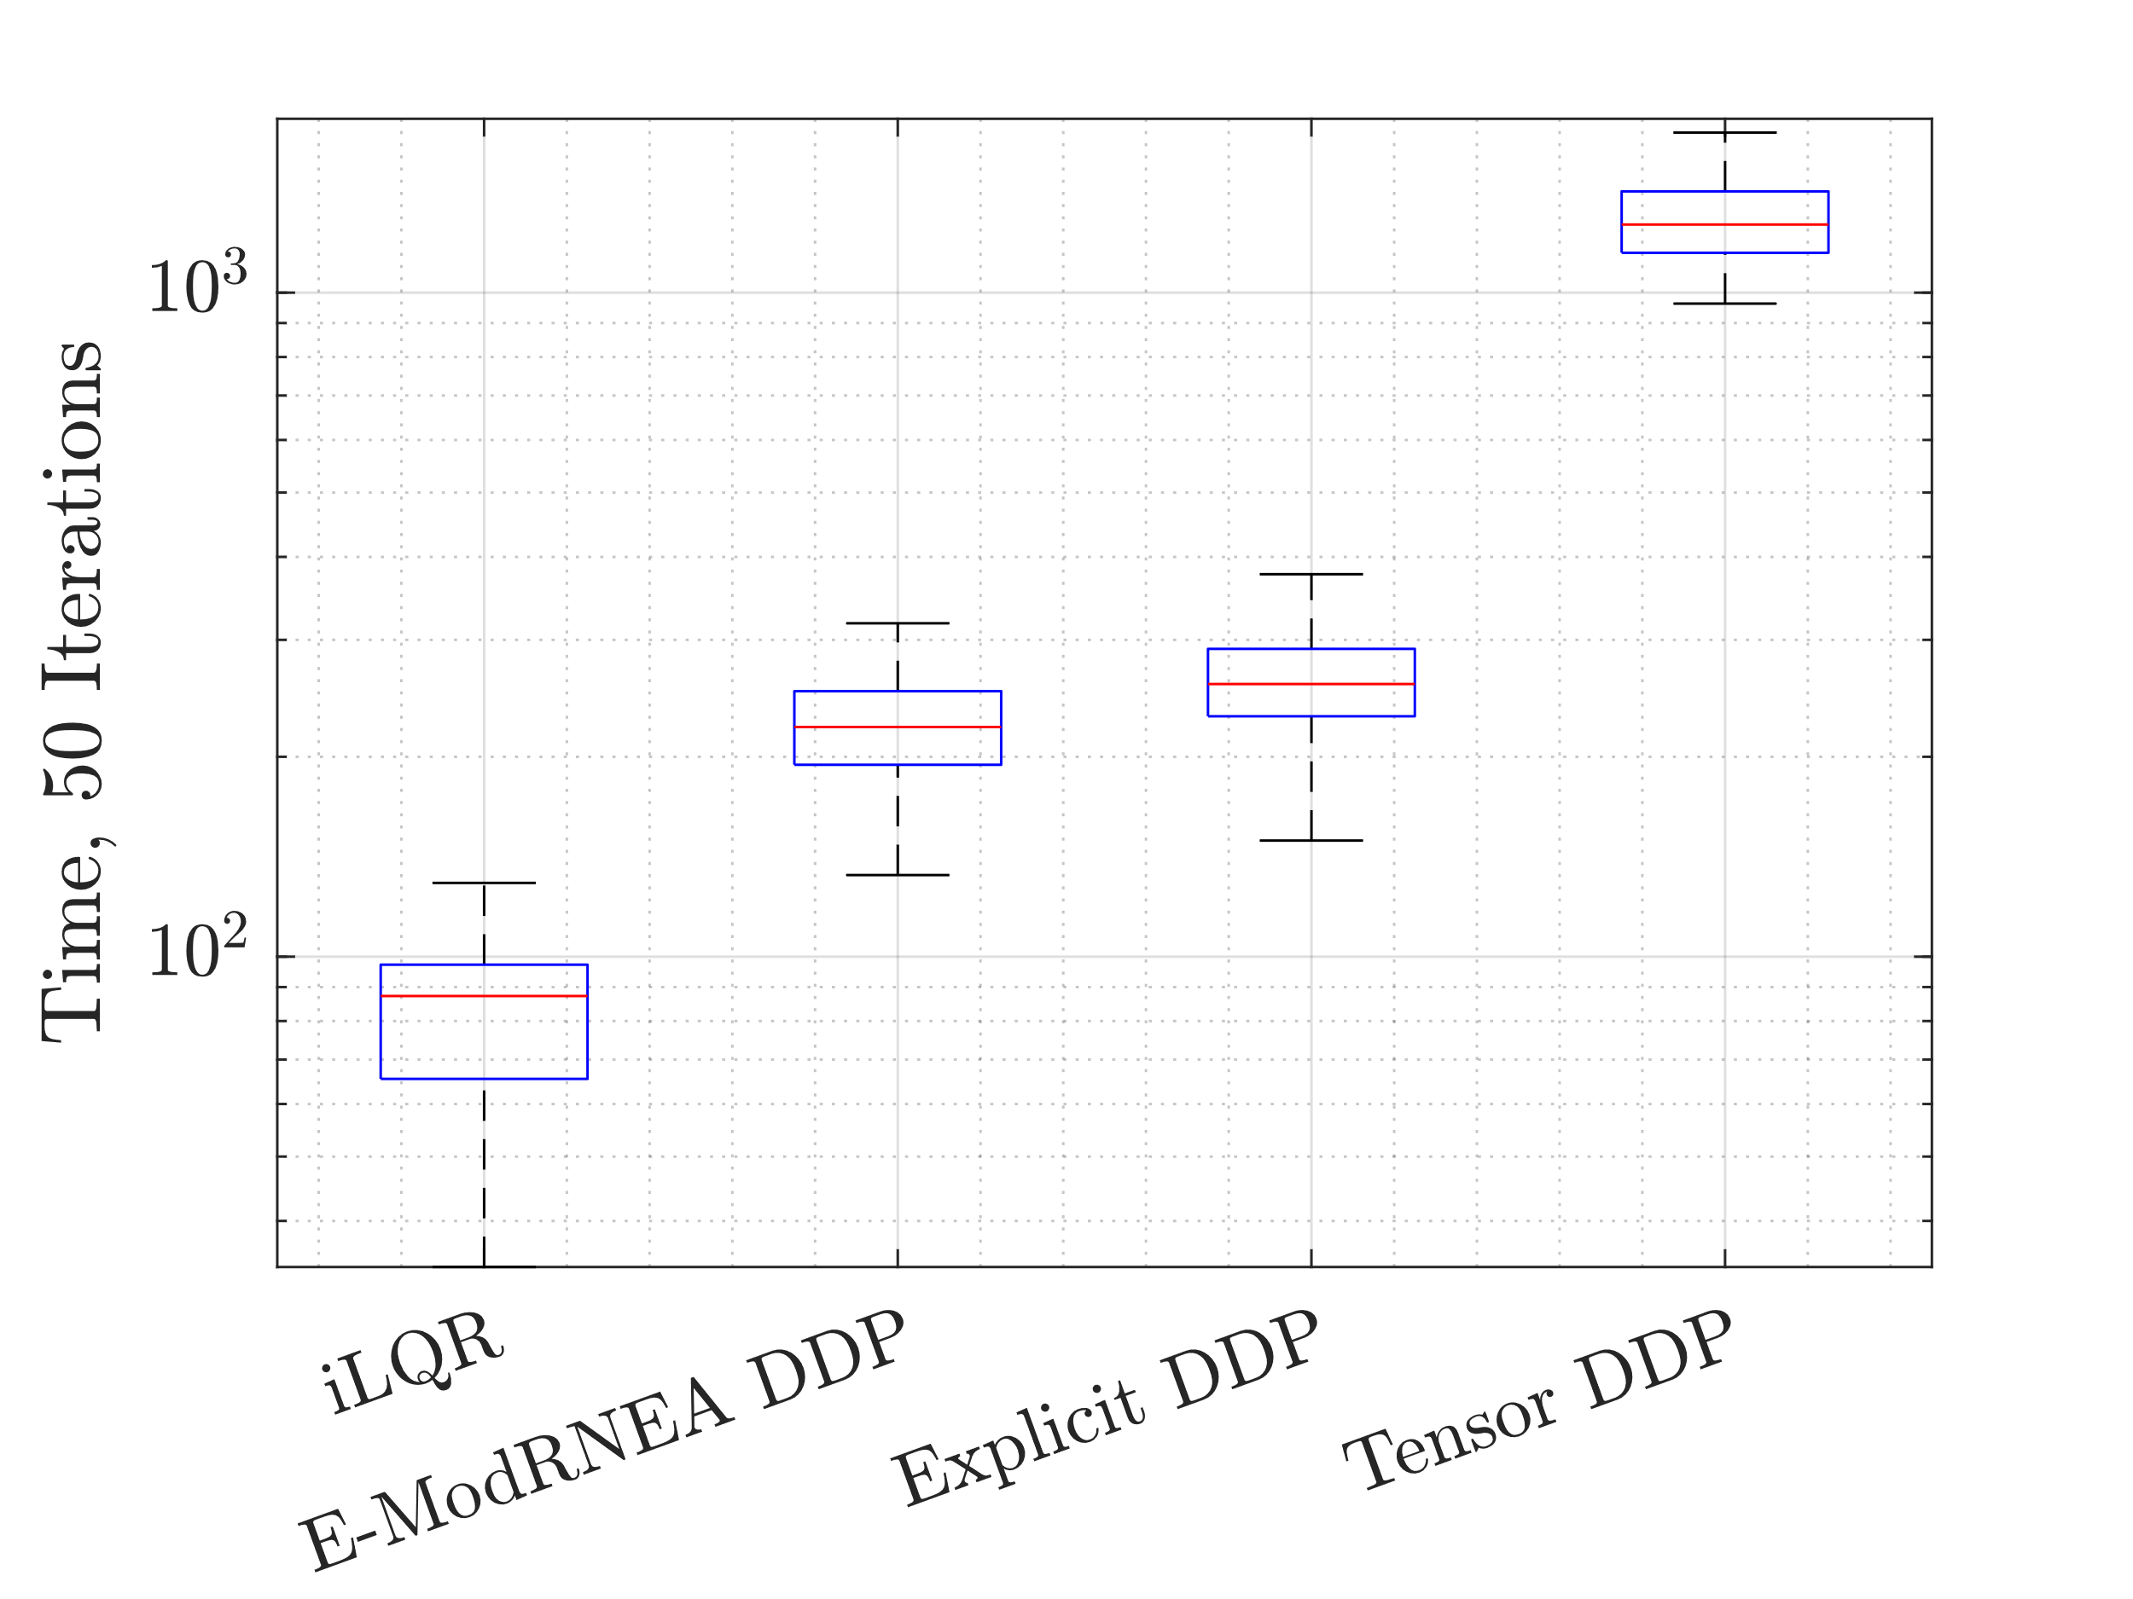
Timing Comparison

Slide 17
Working
Editing paper for publication [Iterative Process]
Looking at extension to allow 3D motions

